Slide 1


PRESENTATION SKILLS

Slide 2

Learning Outcomes
Determine the elements required in making successful presentations
Using verbal and non-verbal communication as an important aspect of conveying an central idea.
Demonstrate Quality oral presentations
Practice effective listening skills
Catch the important massage from the conversation
Paraphrase and counter check message with the speaker.

Slide 3
MISCONCEPTIONS ABOUT PRESENTATION SKILLS
UNIT # 5.1

Slide 4

PRESENTATIONS SKILLS ARE IMPORTANT IN GENERAL
Presentations can have different objectives:
to inform,
to sell something,
to persuade someone,
or to train people.
Academic presentations are mostly meant for informing and training.
What irritates people most during presentations?

Slide 5
This is what irritates people while presentation:
the speaker was nervous
the speaker was disorganised
the speaker never looked at me
the speaker had bad accent
the speaker did not sound enthusiastic
the speaker was monotonous
the visuals were bad
I was irritated by his/her clothing
the speaker was speaking too softly
the speech was confused; I didn’t know what
he/she was trying to tell me

Slide 6

COMMON MISCONCEPTIONS ABOUT PRESENTATION
Good public speakers are born.
You must use PowerPoint.
It’s a boring topic, there’s nothing I can do about it.
Everyone hates public speaking.
I must start my presentation with a joke.

Slide 7
TECHNIQUES OF EFFECTIVE PRESENTATIONS
UNIT # 5.2

Slide 8
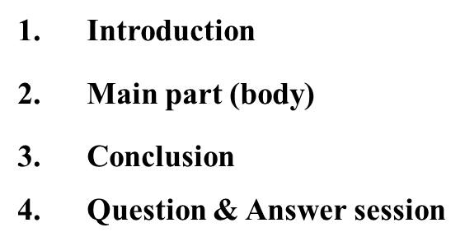
PLAN YOU PRESENTATION CAREFULLY
This is the basic structure of a talk:
This means that you need to plan every part carefully.
Your presentation must tell a story. At this stage you are like a
screen-writer, someone who is writing a play.

Slide 9

Introduction
Introduction is probably the most important part. The
Purpose of the introduction is “to tell the audience what
you are going to tell them”. You should remember that there
is no second chance for a first bad impression. If you start off badly
you will spoil everything.
During the introduction you need to achieve the following aims:
Gain Attention
attract Interest
create Desire
stimulate Action

Slide 10
Getting started - greeting the audience
What you need to do first is to greet your audience. Here are some useful phrases:
Good morning, ladies and gentlemen.
Welcome to my presentation.
It’s very nice to see you all here today.
Can we get started?
Let me say just a few words about my background...
Then you proceed to the introduction to your topic

Slide 11

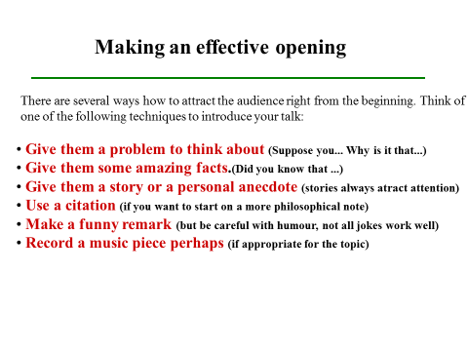

Slide 12
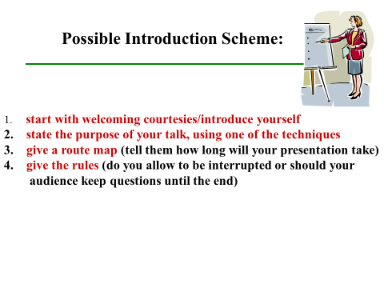

Slide 13
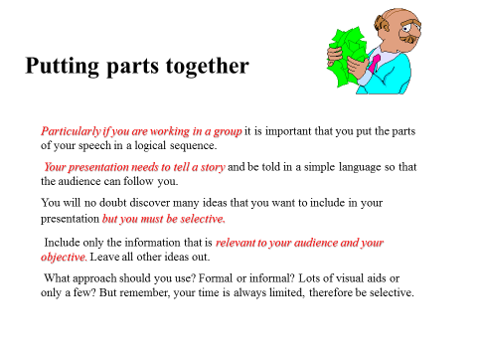

Slide 14
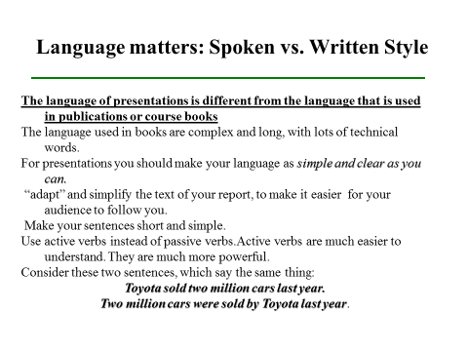

Slide 15
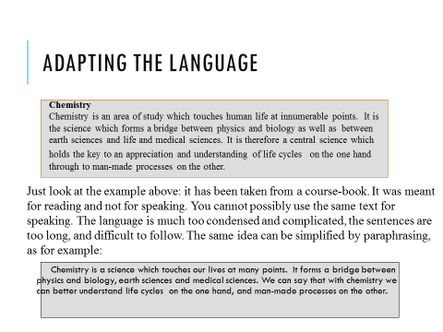

Slide 16
Signposting
Let’s take a look at..
Let’s consider..
When you drive on roads you follow the signs and you cannot get lost. Similarly, when you give a presentation, you need to give signals to your audience to know where they are and what is coming next. They know it because you tell them by giving signposts at the beginning and all along the way. This technique is called 'signposting' (or 'signalling').
Look at this example:
I’d like to...
Let me now turn to...
To go back for a moment...
"I'll start by describing the current position in Europe. Then I'll move on to some of the achievements we've made in
Asia. After that I'll consider the opportunities we see for further expansion in Africa.
Lastly, I'll quickly recap before concluding with some recommendations."

Slide 17
Use singposting in your presentations
Singposting is the halmark of the language of presentations. The more you use
the signposting phrases, the lighter and easier the language becomes.
Singposting phrases will help you lead your audience; they will know where you
are going. See the example below:
Good afternoon everybody. I’d like to thank you all for coming here today and listen to me. I hope by the end of the day you will leave with a knowledge of what equipment can do for you and how the government can benefit by using it.
If you would like to take notes, please do so. However, all of you will be given a handout at the end of my presentation.
I am going to talk today about a new product, a breath control measurement instrument ALCOTEST. The first such product was introduced to the market 40 years ago and has been used all over the world.
The new range of products I’m going to familiarise you with are the Alcotest 7110 MK III and Alcotest 7410. Now, the main purpose of the talk, of my talk, is to outline the major benefits of using these models.
Before doing so, I would like you to look at some general technical features which I hope you will find encouraging. Then I’ll move on to the benefits for the users.
Let’s look at some figures. I’ll put them on the screen now. As you can see the Alcotest comes as a portable instrument, integrated in a metal case, including heatable sampling hose, a 40-digit alphanumerical display, integrated printer, mains connection and 12 V battery.

Slide 18
Ending your talk
When you come to the end of your presentation you need to indicate this to the people. Don’t just end up abruptly without giving a conclusion.The purpose of the conclusion is to “tell the people what you have told them”.
Follow this scheme:
summarise facts
give recommendations
give proposals
Thank the audience
Invite questions

Slide 19
CONCLUSION:
Simplify the text.
Focus your material. You can’t say everything.Make central Idea.
Use transitions (signsposting) to move smoothly.
Use examples, anecdotes, statistics to support your message.
Use visuals to reinforce the message.
Consider timing.
Practise alone and with the whole group

Slide 20
HOW TO HANDLE DIFFICULT QUESTIONS
UNIT # 5.3

Slide 21
Different aspects
To avoid any negative outcome the following aspects are important in making a presentation:
Preparation and planning
Language of presentations
Visuals/equipment
the presentation itself.

Slide 22
When you plan your presentation you need to answer the following questions:
Who is my audience (how much do they know about my topic?)
How am I going to organise my topic? (it needs to tell a story)
How long should my presentation be? (you will have time limits and you need to say everything within that limit)
What visual support shall I use? (PowerPoint, transparencies, models, objects...?)

Slide 23
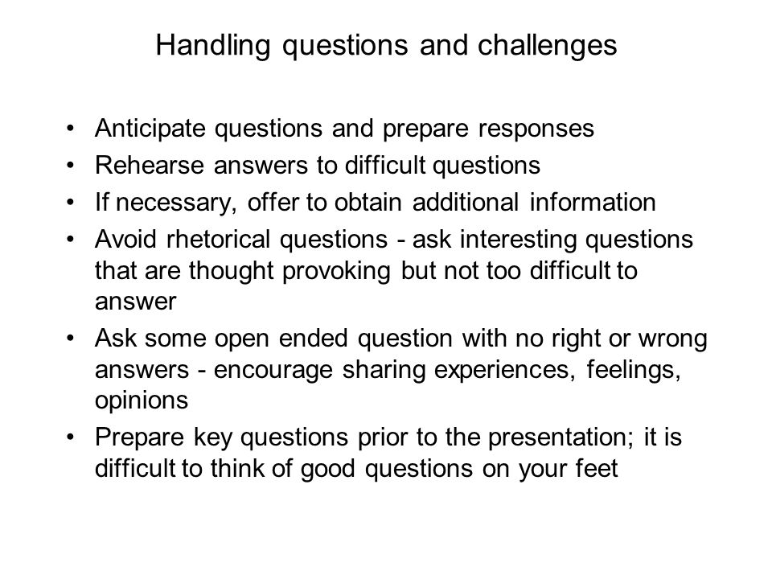

Slide 24
1/6/6 RULE AND 10/20/30 RULE
UNIT # 5.4

Slide 25
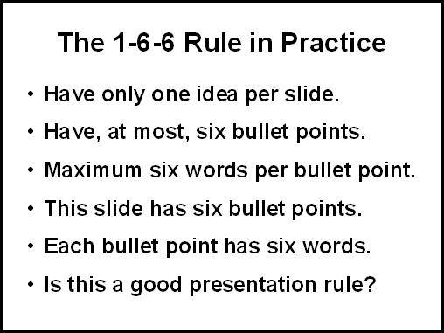
1/6/6 RULE IN PRESENTATION

Slide 26

10/20/30 RULE OF PRESENTATION

Slide 27


